Slide 1
Inventory Management System
Individual Project
Presentation by: Tawanda Siyamachira

Slide 2
Scope
This project aims to create an application that an end user can interact with via a CLI (Command Line Interface. The application is to be created using Java as the programming language which interacts with a Managed Database through SQL queries.
This is to be achieved by utilising methodologies that have been covered in previous modules such as CRUD functionality for the Customers, Items and Orders entities.

Slide 3
Specification
The project is to be achieved by the implementation of the following concepts;
Agile & Project Management - a Kanban board with user stories and tasks needed to complete the project.
Databases - a relational database will be used to store data persistently for the project, with at least 3 tables that exhibit functionality relationships.
Programming Fundamentals - a functional application that adheres to best practices and design principles, composed in Java language and meets the requirements set on your Kanban Board.
Automated Testing - unit tests and integration tests are used to validate application.
Continuous Integration - use of Version Control System to fully integrate the code into a CI server and deployed to an artifact repository manager.

Slide 4
Consultant Journey
During the course of this project, the implementation of various methodologies and technologie were practically implemented:
Setting-up and manipulating database systems respective to the project specification.
A competent amount of understanding of the programming languages that were implemented in the project scope.
An understanding of the importance of manual and automated testing. As well as composing test cases for the respective main classes.
Reviewing and Addressing Issues, Code Smells and Security Hotspots.
Effective use of a version control system in order to keep the project backed up and accessible to all parties and technologies that utilise the repositories.
Managing and tracking the project by the use of Agile Project Management methodologies, as this is essential in order to address the product specification and milestones.
WHAT I HAVE LEARNED.

Slide 5
Consultant Journey
Database: GCP MySQL server
Programming language: Java and MySQL
Testing framework: JUnit
Version Control system: Git
Host of version control system repository: GitHub
CI Server: Jenkins
Cloud server: GCP virtual machine aided by Sonarqube.
Artifact Repository Manager: Nexus
WHAT TECHNOLOGIES/CONCEPTS WERE IMPLEMENTED.

Slide 6
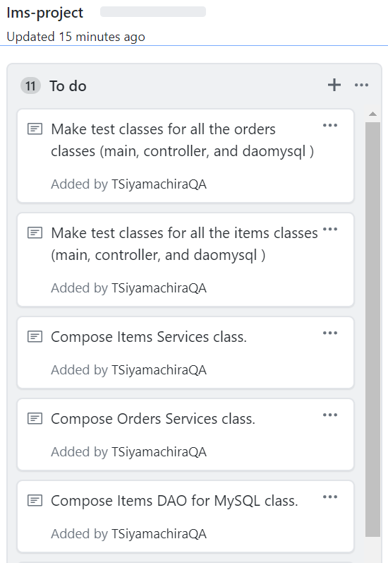
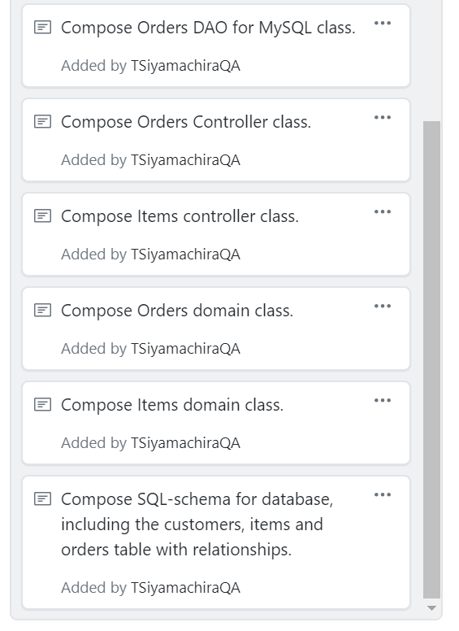
Initial Plans (Initial Kanban Board)
In the initial phase of the project a Kanban Board was composed in order to address the project specification as user-stories that can be approached as individual tasks.
The user-stories were constantly updated as there were several emergent tasks due to the nature of the project.

Slide 7
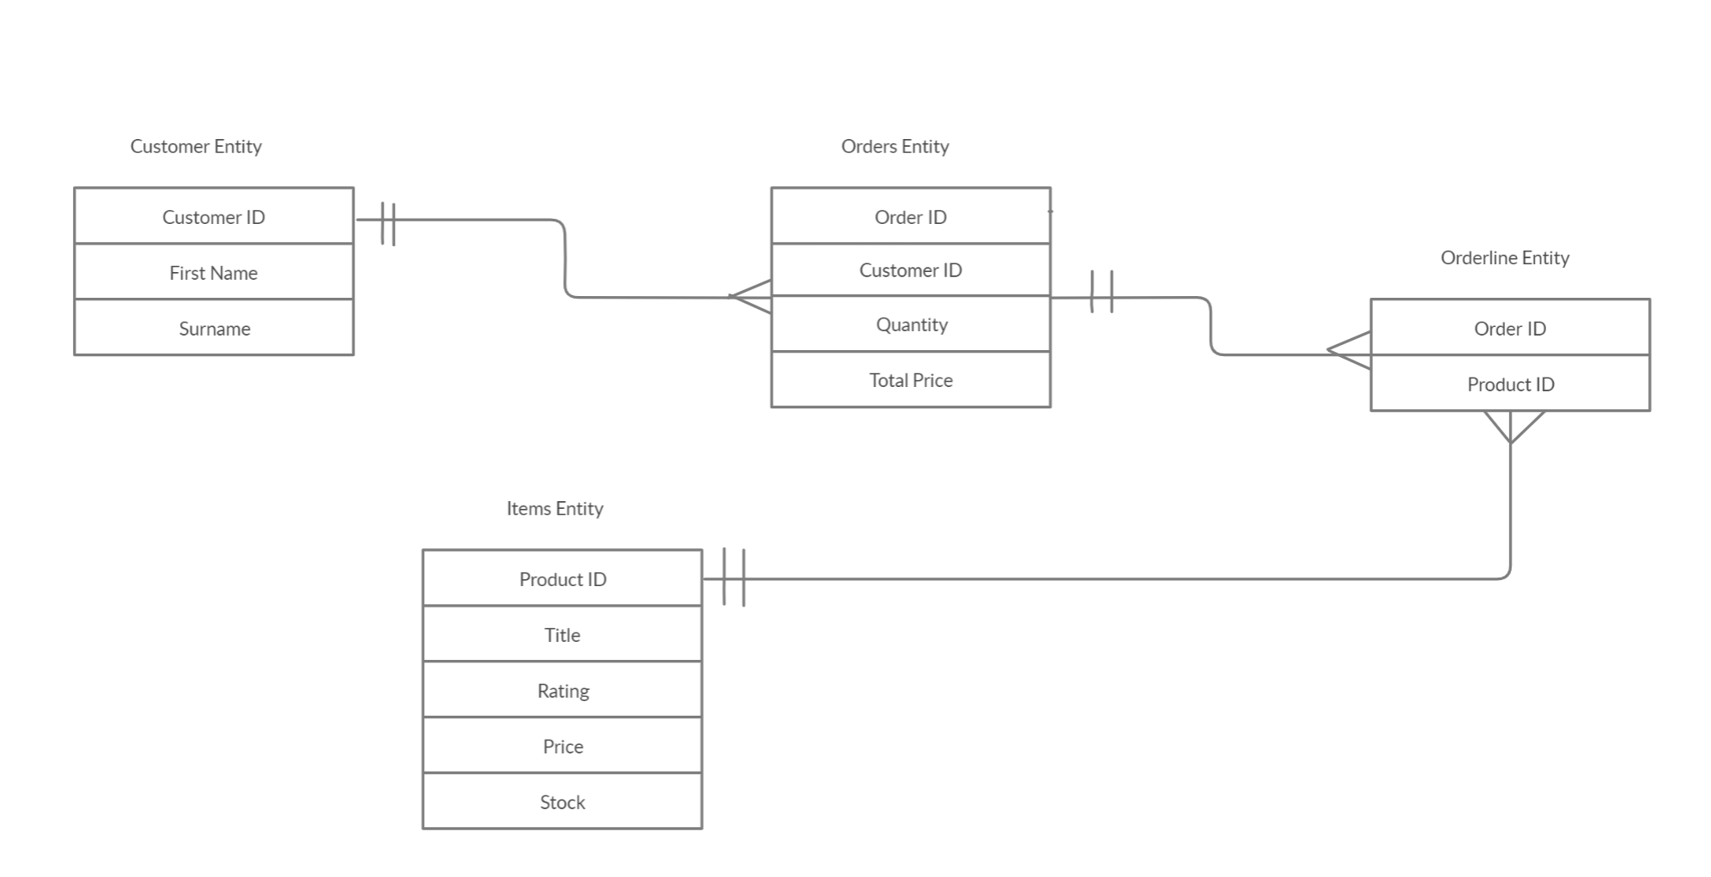
Entity Relationship Diagram (ERD)

Slide 8
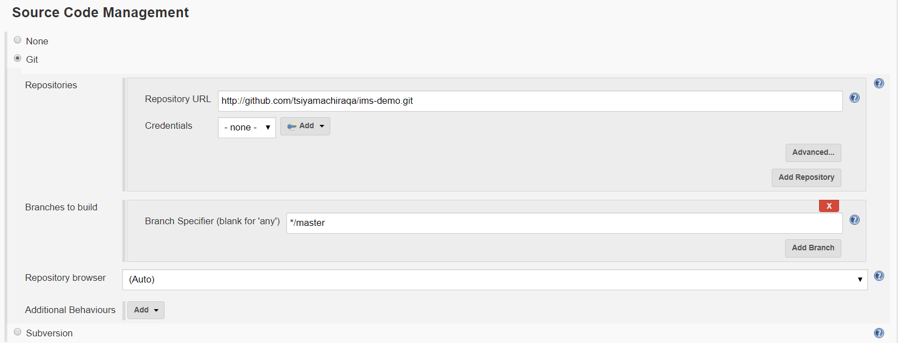
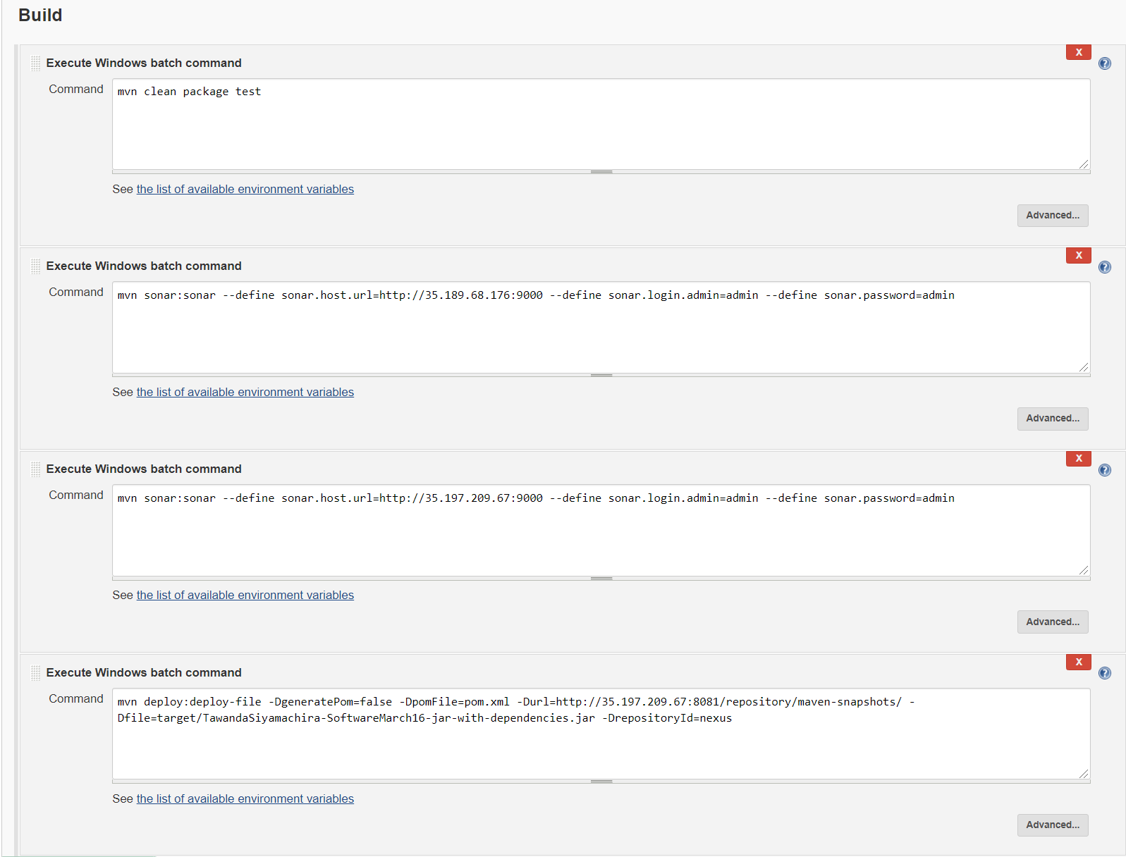
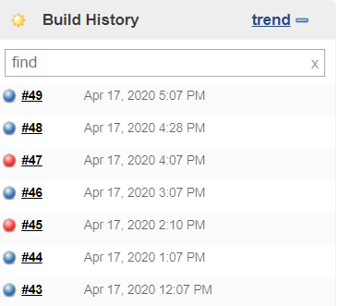
Continuous Integration (C.I Pipeline)

Slide 9
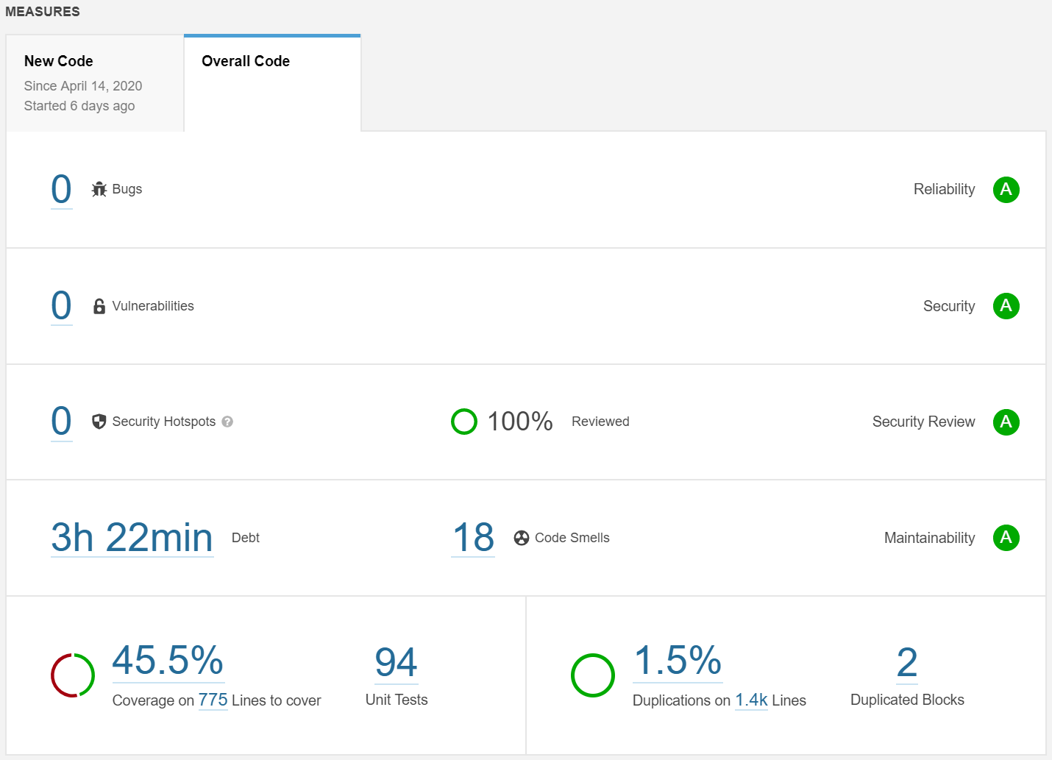
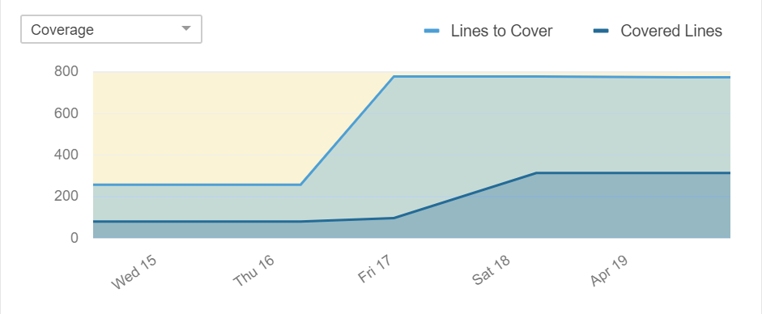
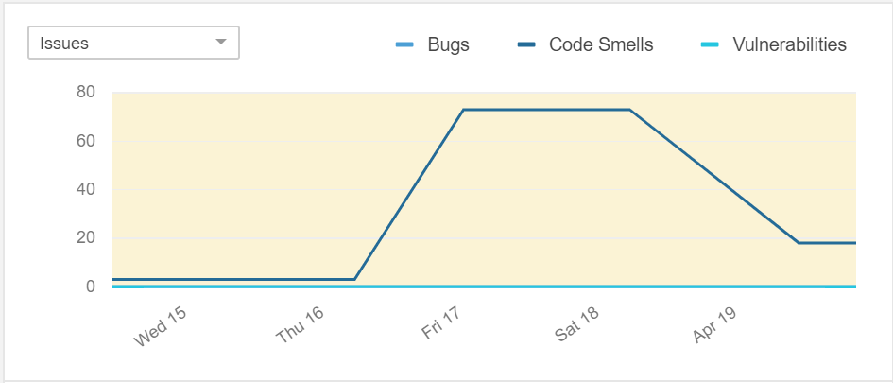
Sonarqube

Slide 10
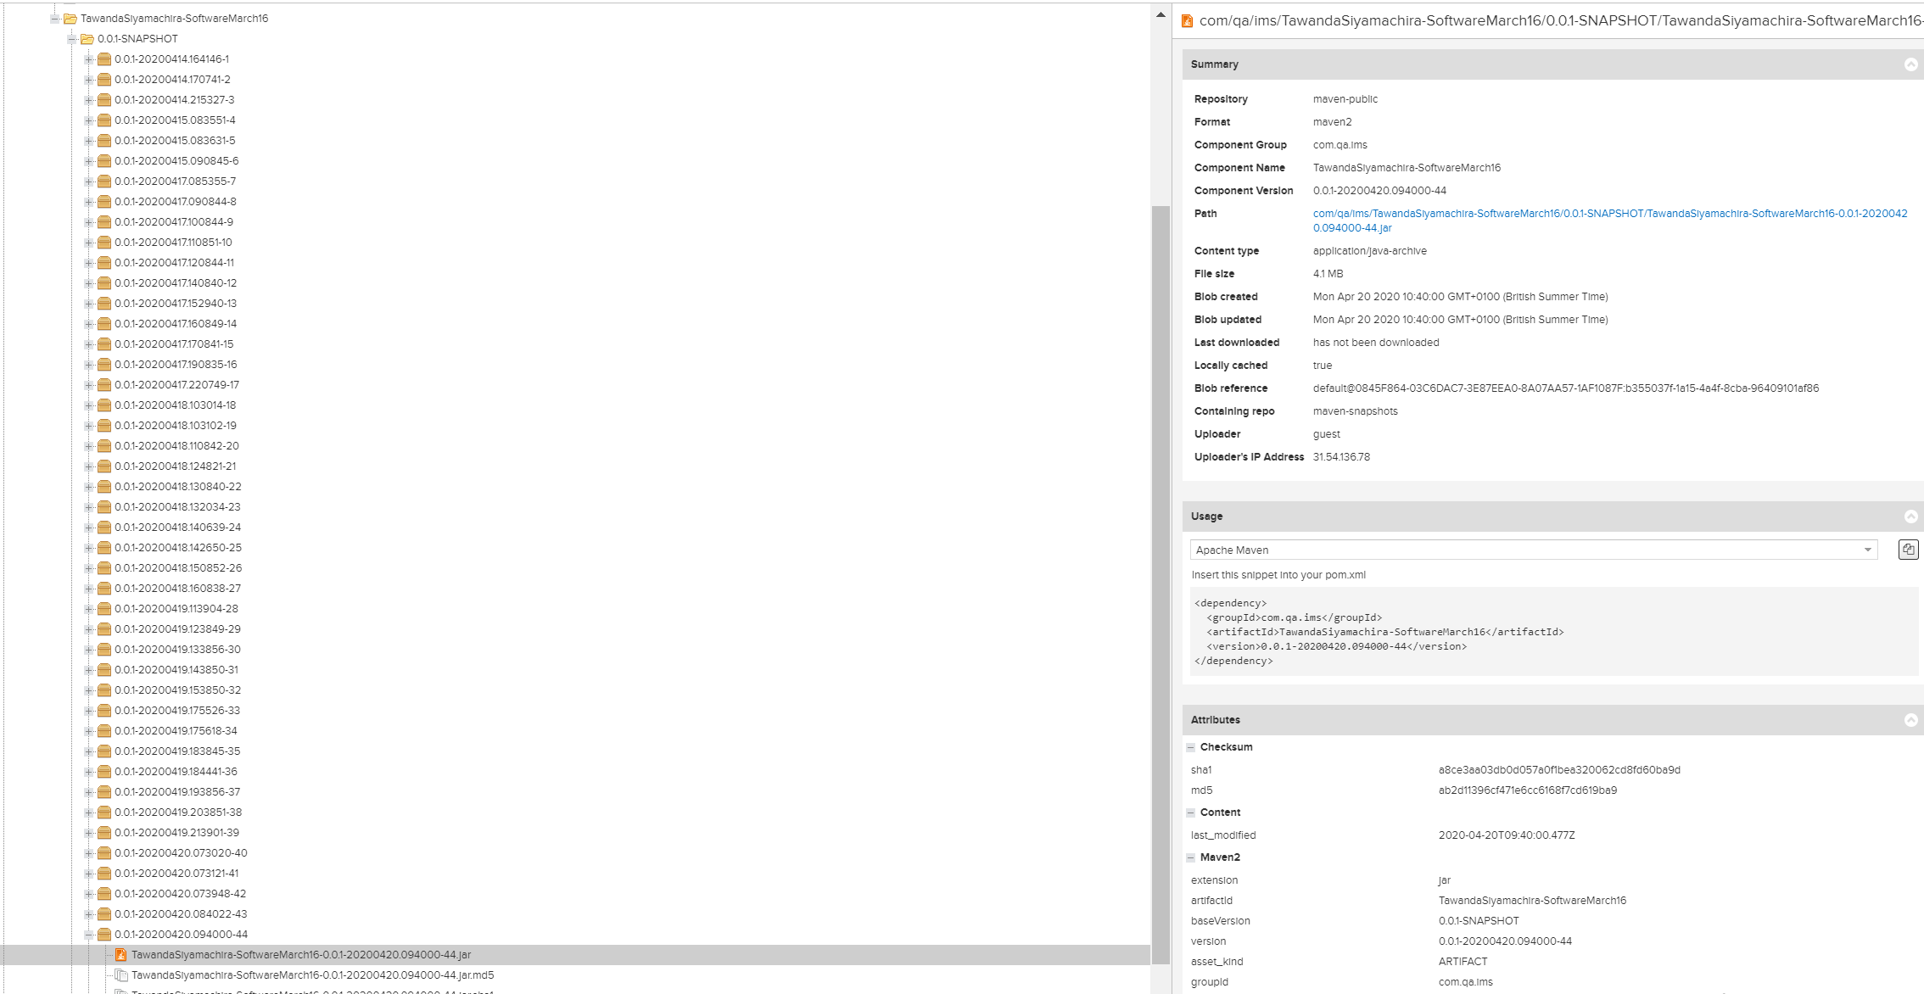
Nexus (Fat.jar)

Slide 11
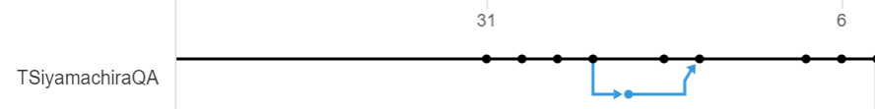
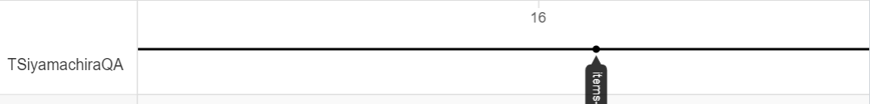
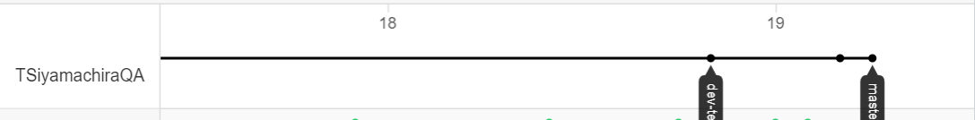
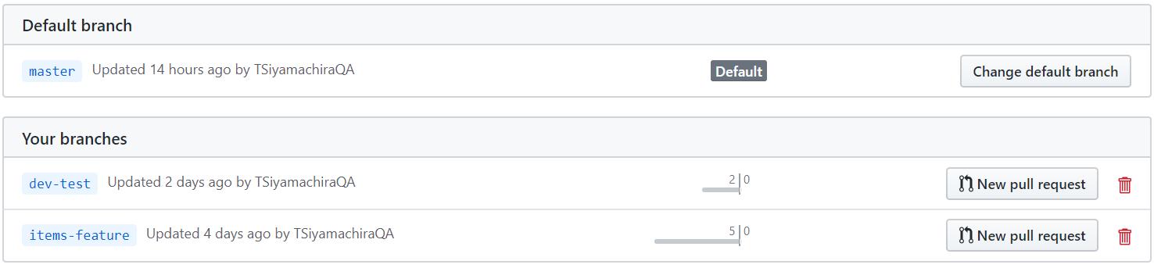
Feature-Branch Model
The feature-branch model was implemented throughout the whole project in order to add features to the code.
This model was also used to preserve the integrity of the master branch, for version control.

Slide 12
Application Demo

Slide 13
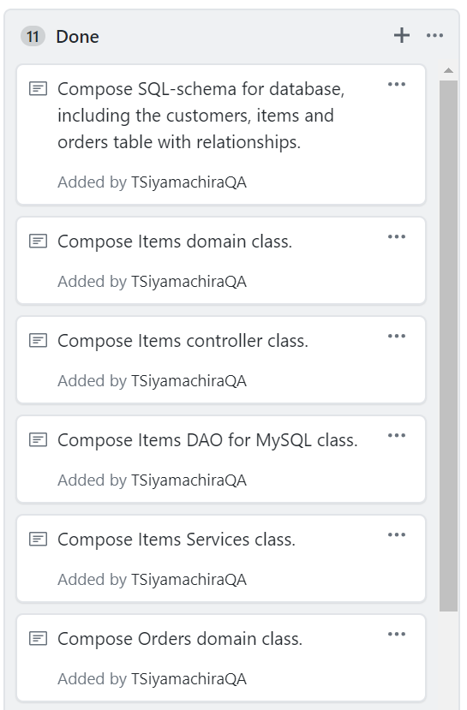
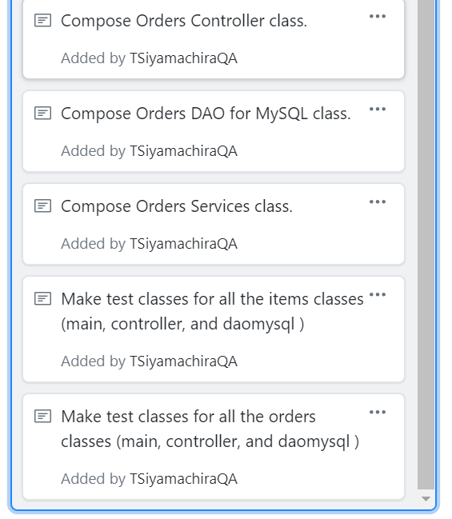
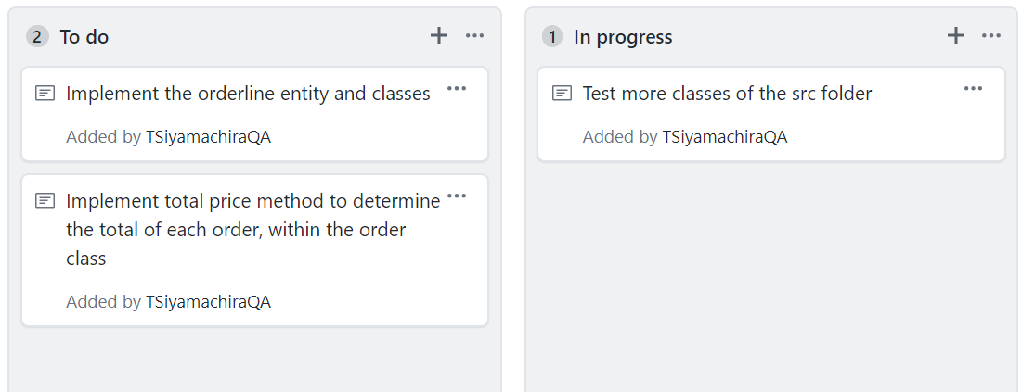
Sprint Review (Final Kanban Board)

Slide 14
Sprint Review
WHAT WENT WELL
Good understanding and implementation of Java language and SQL query commands.
Implementation of class inheritance and java object classes for entity relationships.
Good understanding of writing test classes for J-Unit tests.
Setting-up and conducting automated tests, as well as addressing any security hotspots or code smells.
Setting up and running SQL database instances on GCP.
Setting up Sonarqube VM via GCP.
Setting up a C.I pipeline that's effective to project objectives.
WHAT CAN IMPROVE/MOVING FORWARD
Implementation of total method to allow the automation of the total order price.
Entity relationship between orders entity and orderline in order to automatically determine the relationships between the orderID and the productID from the items entity and the orders entity.
Improve the domain class such that more/varied functions can be implemented to address the entity functionality.
Implement a loop function in the “ims” main class, this will allow the user to be able to use the application without constantly having to login.
RETROSPECTIVE/CONCLUSION

Slide 15
QUESTION TIME
Any Questions?

